Slide 1
Human 3D face annotation
Rohit Kumar supervised by Dr.Nils Hasler
A work for The Captury, Saarland, Germany

Slide 2
Overview
Problem statement
Understanding dataset
Setting up development
Blender Mesh setup
Solution chart
Step by Step explanation
References
My further ideas and analysis

Slide 3
Problem Statement
To understand 3D face annotation, it’s easy to derive the relation from 2D face annotation.
2D face annotation
We are given an image
We need to detect the face
We need to do landmark annotation on detected face
3D face annotation
We are given a mesh with texture. Consider that person in mesh keeps moving, it is not static.
Since it’s 3D there can be multiple perspective to view the mesh.
Problem 1 : How do you find a camera location so that we can detect a face in the camera view ( a 2D image ) ?
Once we detect face in some camera view, it’s a 2D landmarks annotation problem.
Problem 2 : We solve problem 1, than we have landmarks of 2D image, how do you find the 3D correspondances ?

Slide 4
Understanding Dataset
From Wikipedia
Three-dimensional (3D) models represent a physical body using a collection of points in 3D space, connected by various geometric entities such as triangles, lines, curved surfaces, etc. Being a collection of data (points and other information), 3D models can be created manually, algorithmically (procedural modeling), or by scanning. Their surfaces may be further defined with texture mapping.
In our case, the dataset is a human frames of 3D meshes, just like how 2D frames are but in form of 3D meshes at each frame.
A circular view around the mesh looks like the image attached.

Slide 5




Setting up the development Environment
To interpret a 2D image, we need an image viewer.
To interpret a 3D mesh, we need a 3D software.
Our task is to construct a pipeline from human face annotation. A software that supports scripting would be nice.
Blender provides a support for python scripting, as well as it is open-source and free to use.
Used OpenCV’s implementation for face detection ( DNN as well as Haar Cascade ).
Used Dlib’s facial landmarks annotation support.

Slide 6
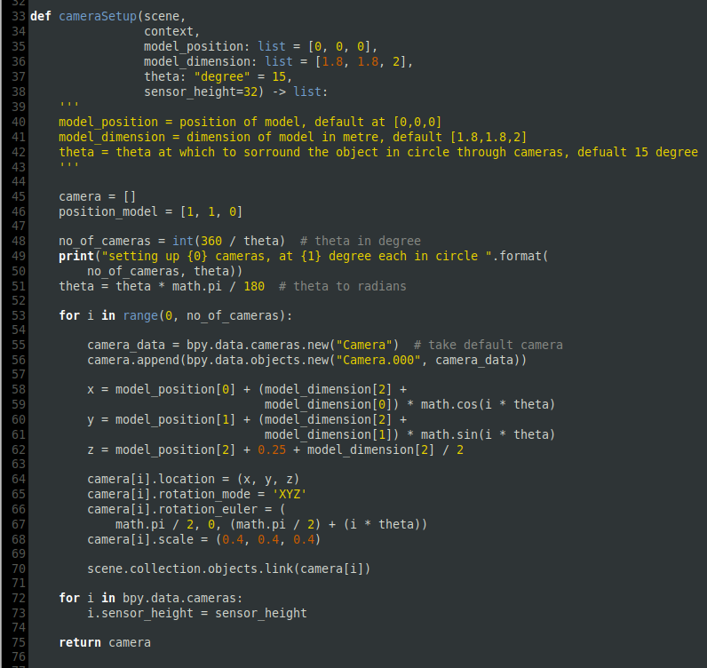
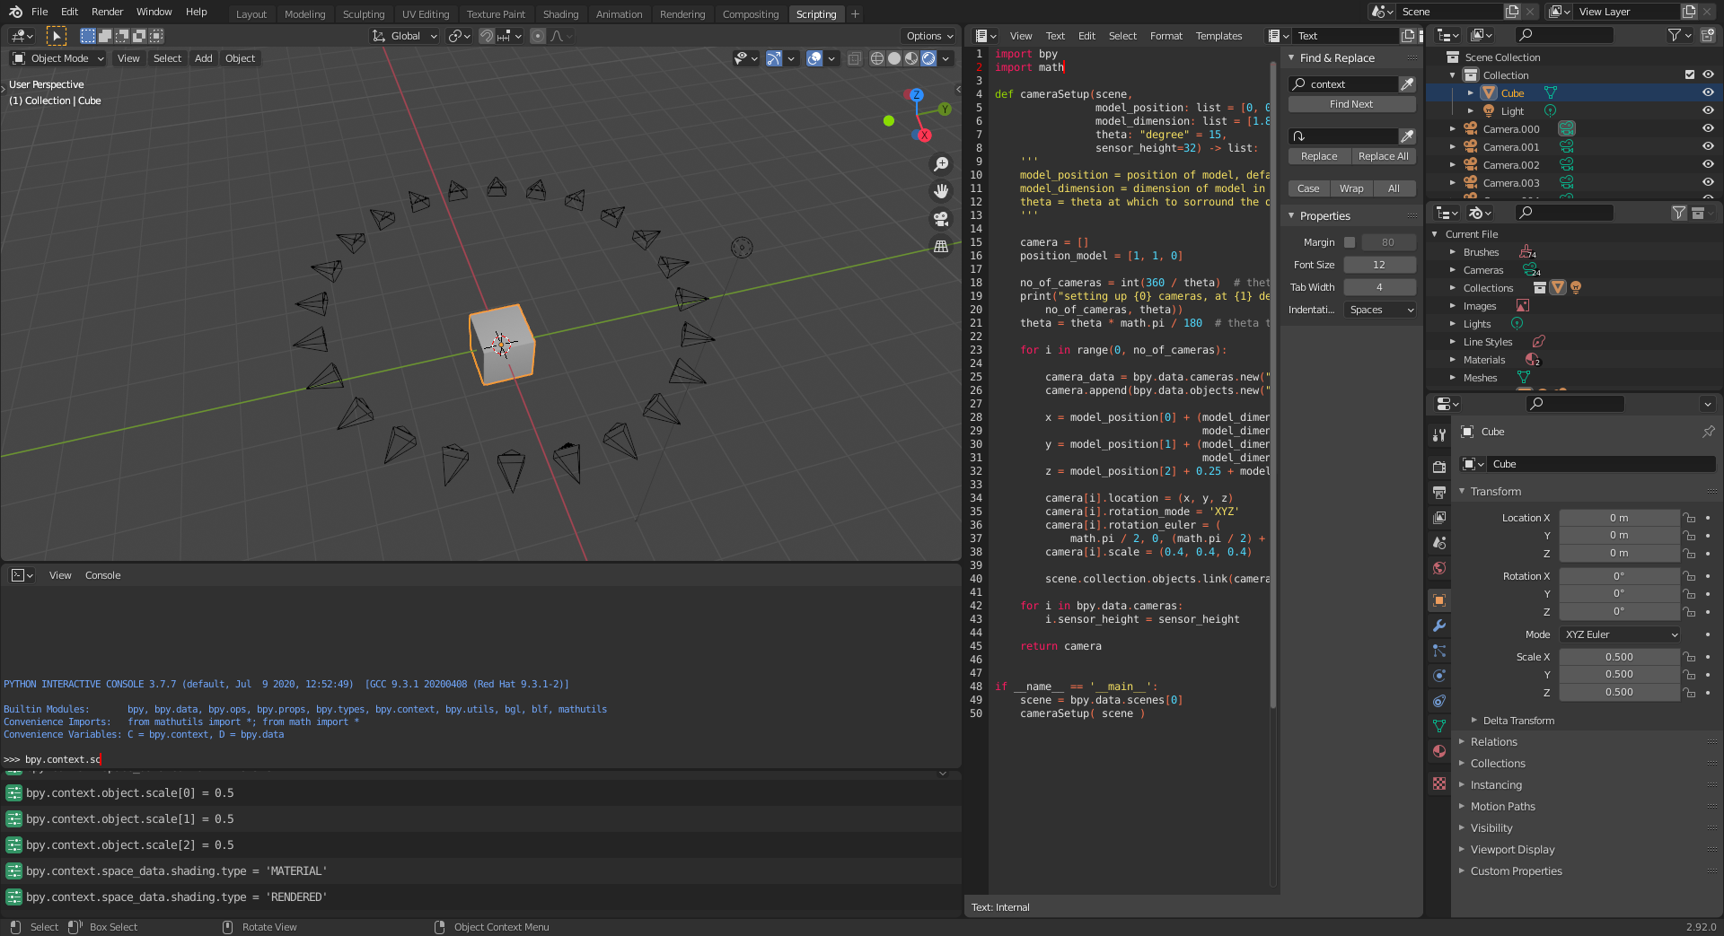
Blender Mesh Setup
Setup cameras in a circle around the mesh. 15 degree separation would be good.
A python code similar to this would work.

Slide 7
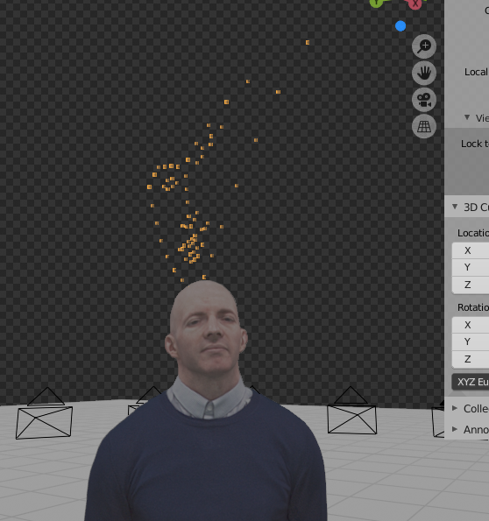
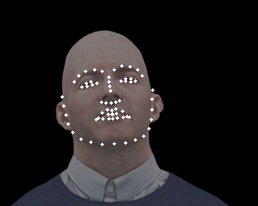
Solution Chart
Import mesh in Blender
Get 2D images in all
cameras perspectives
Find the most frontal
view in all images
Annotate the face
landmarks
Solve Classically
Multiview-geometry problem
Backproject to 3D
Blender Raycast
method

Slide 8
Step 1 : Import mesh in Blender
Write a generic python script that
Setup scene, camera, lights, parameters, etc.
Renders the view in every camera perspective

Slide 9
Step 2 : Find the most frontal image
Given : 24 images ( if camera at 15 degree separations )
Detect face in the images using either **openCV’s haar Cascade detector or DNN detector.
Prepare the list of images that have face detected.
Now choose the central image in the sequence. It is the most central view ( or 2nd most central view which also works fine for us due to quite less separation b/w cameras. We can reduce cameras separation from 15degrees to 10 degrees )
** I found that choosing weak detector is better for us I.e openCV’s Haar Cascade method is better from the dnn’s one. It is because the dnn model has a strong affinity to detect face even if only partial view is present. We want to reject those cases.

Slide 10
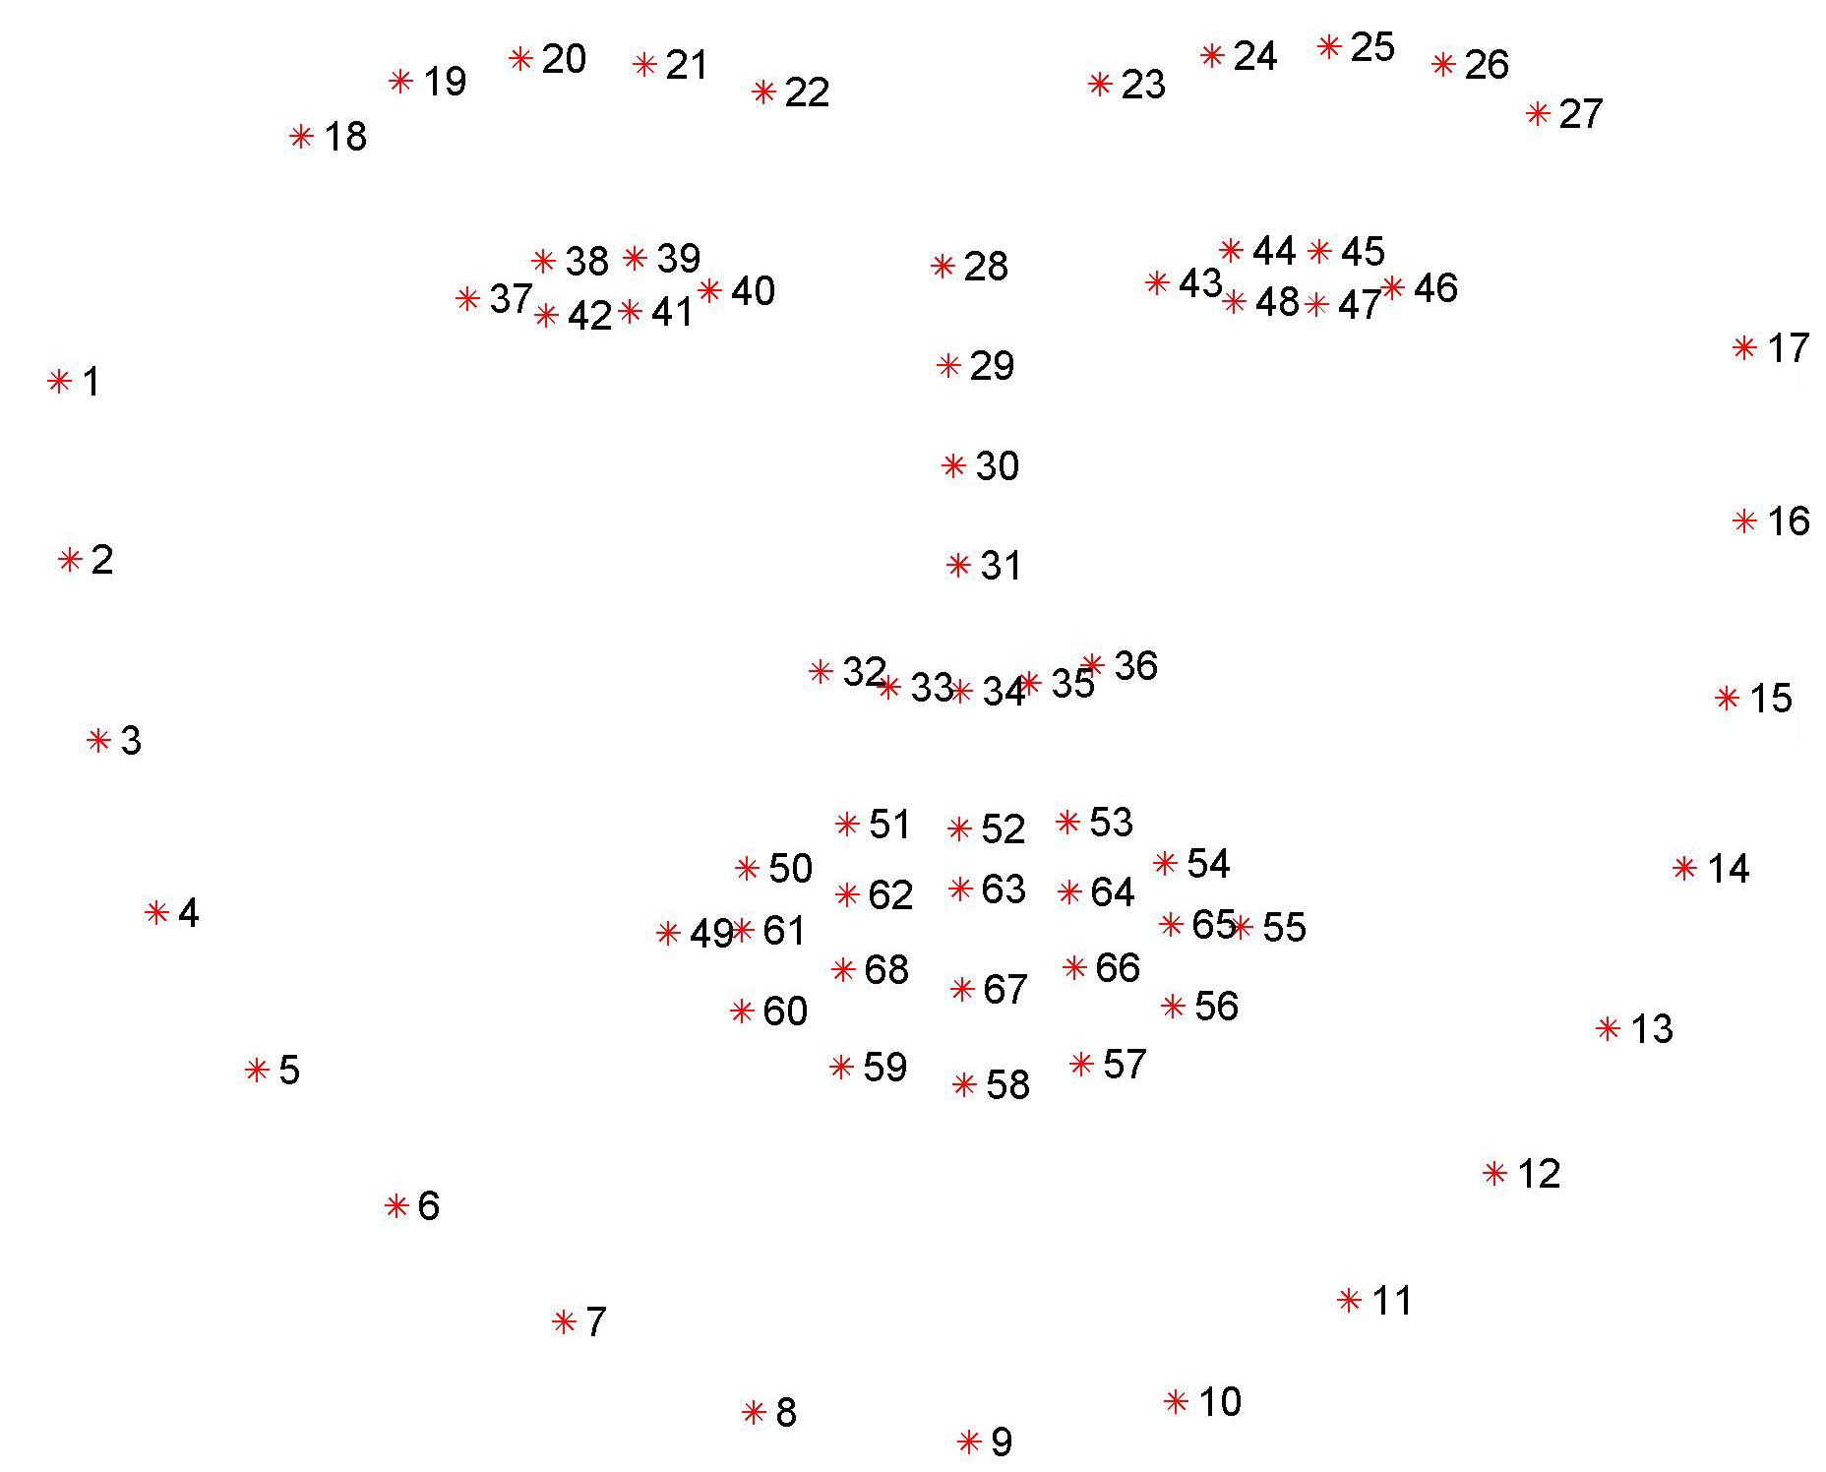
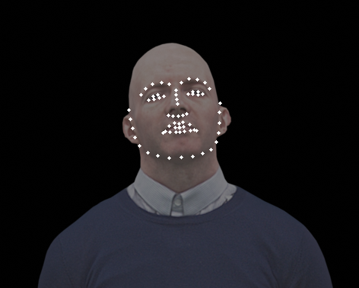
Step 3: Annotate the face landmarks
Annotate the central face with 68 points landmarks detector implemented in Dlib here
Those 68 have correspondances to eyes, nose, lips, etc. as shown in image.

Slide 11

Back-project to 3D
Multi-View geometry Method
We need to project the landmarks we got to the 3D mesh.
One way to think over it is by multi-view geometry.
However reconstructing by this method will have noise.
Blender Ray-Cast Method
Blender supports ray-cast method and has it’s implementation built in it’s API.
See references to read more about it.

Slide 12
References
A big thanks to Blender communitites for their discussions.
Blender Docs, Blender Stack Exchange, Blender Artists
Learn openCV blog on face detection and landmark annotation
towards data science blog
Semantic Scholar, a review of current methods
Head pose estimation using opencv and dlib
Retrieve the depth from the renderer:Retrieve the depth from the renderer
Given the camera matrix and the depth you can compute the 3d coordinate
Raycast
Discussion on raycast

Slide 13
Further Ideas
The problem of finding the most frontal view can also be viewed as a differential rendering problem.
We need a camera pose that minimizes the difference b/w the current view through it and a general representation of how frontal human view looks like.
Pytorch3DPytorch3D supports this type of rendering. I worked with it. However as it is in it’s initial phase, there is a bug reported by me which causes memory overflow due to which I was not able to continue with the experiment.
Pytorch3D tutorials

